Slide 1
Ratio and Proportion
L - 1
Department of Career Planning & Development (DCPD)
Notes:
1

Slide 2
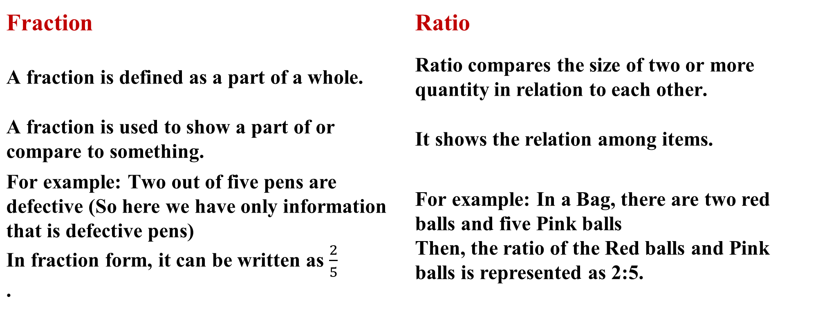
Difference between Fraction and Ratio
Fraction | Ratio
A fraction is defined as a part of a whole. | Ratio compares the size of two or more quantity in relation to each other.
A fraction is used to show a part of or compare to something. | It shows the relation among items.
For example: Two out of five pens are defective (So here we have only information that is defective pens) In fraction form, it can be written as $\frac{2}{5}$ . | For example: In a Bag, there are two red balls and five Pink balls Then, the ratio of the Red balls and Pink balls is represented as 2:5.
Department of Career Planning & Development (DCPD)
Notes:
2

Slide 3
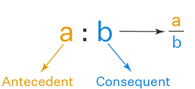
RATIO (KEY PONTS TO REMEMBER)
RATIO:
When two or more similar quantities are compared, then to represent this comparison, ratios are used.
The sign used to denote a ratio is ‘:’
A fraction can be represented in the form of ratio a:b and vice versa.
The ratio should exist between the quantities of the same kind
While comparing two things, the units should be similar
The comparison of two ratios can be performed, if the ratios are equivalent like the fractions
| RATIO PROPORTION AND VARIATION | DISCOVER . LEARN . EMPOWER

Slide 4
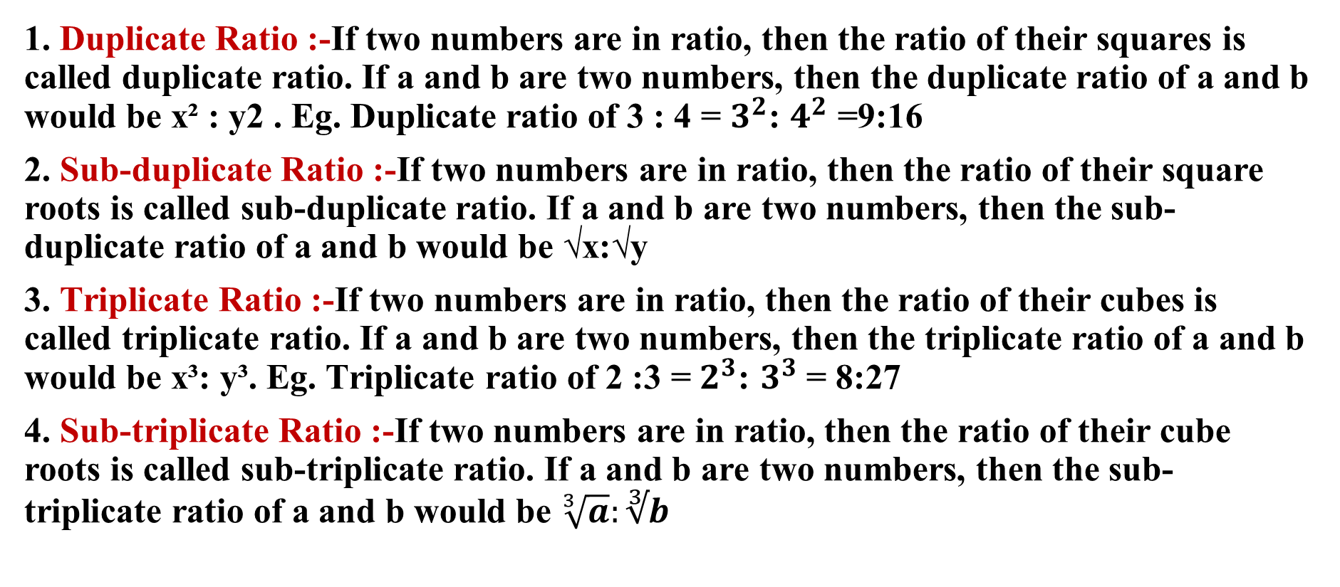
TYPES OF RATIO
1. Duplicate Ratio :-If two numbers are in ratio, then the ratio of their squares is called duplicate ratio. If a and b are two numbers, then the duplicate ratio of a and b would be x² : y2 . Eg. Duplicate ratio of 3 : 4 = $3^{2}$: $4^{2}$ =9:16
2. Sub-duplicate Ratio :-If two numbers are in ratio, then the ratio of their square roots is called sub-duplicate ratio. If a and b are two numbers, then the sub-duplicate ratio of a and b would be √x:√y
3. Triplicate Ratio :-If two numbers are in ratio, then the ratio of their cubes is called triplicate ratio. If a and b are two numbers, then the triplicate ratio of a and b would be x³: y³. Eg. Triplicate ratio of 2 :3 = $2^{3}$: $3^{3}$= 8:27
4. Sub-triplicate Ratio :-If two numbers are in ratio, then the ratio of their cube roots is called sub-triplicate ratio. If a and b are two numbers, then the sub- triplicate ratio of a and b would be $\sqrt[3]{a}:∛b$

Slide 5
TYPES OF RATIO
5. Inverse Ratio:- If two numbers are in ratio, then their antecedent and consequent are interchanged and the ratio obtained is called inverse ratio, If a and b are two numbers and their ratio is a : b, then its inverse ratio will be y:x. For example Inverse ratio of 4 :5 is 5 :4. 6.
6. Compound Ratio:- If two or more ratios are given, then the antecedent of one is multiplied with antecedent of other and respective consequents are also multiplied. If a : b, c : d and e : f are three ratios, then their compound ratio will be ace: bdf
The compound ratio of 2:5,6:7,9:13= 108/455
| RATIO PROPORTION AND VARIATION | DISCOVER . LEARN . EMPOWER

Slide 6
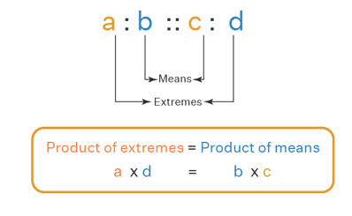
PROPORTION (KEY POINTS TO REMEMBER)
PROPORTION:-
Proportion is an equation that defines that the two given ratios are equivalent to each other.
When two ratios are equal in value, then they are said to be in proportion. In simple words, it compares two ratios. Proportions are denoted by the symbol ‘::’ or ‘=’
| RATIO PROPORTION AND VARIATION | DISCOVER . LEARN . EMPOWER

Slide 7
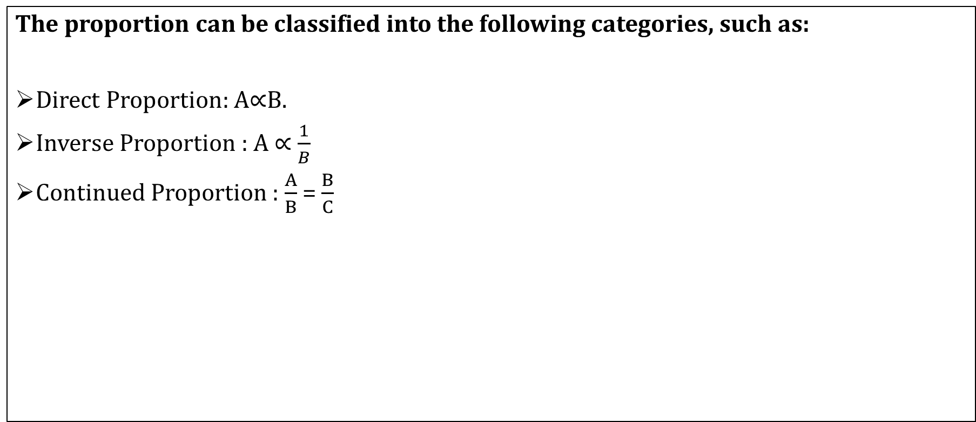
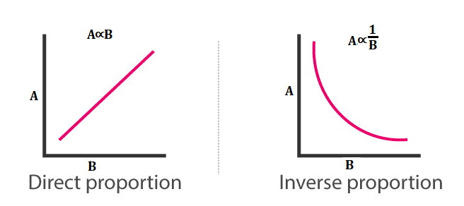
CLASSIFICATION OF PROPORTION
| RATIO PROPORTION AND VARIATION | DISCOVER . LEARN . EMPOWER

Slide 8
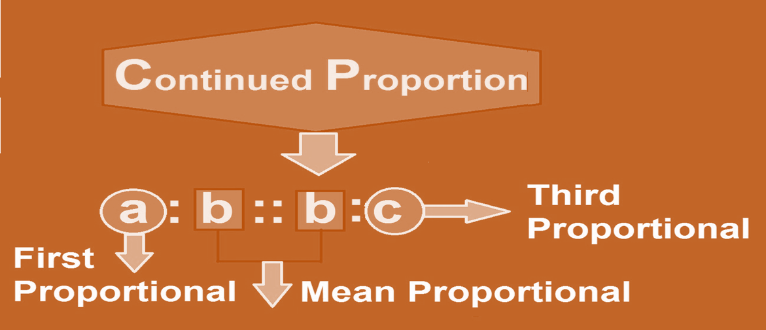
CONTINUED PROPORTION
| RATIO PROPORTION AND VARIATION | DISCOVER . LEARN . EMPOWER

Slide 9
Types of Questions
Basic Questions
Question based on consecutive ratio
Question based on Distribution ratio
Questions based on income expenditure
Questions based on Coins
Questions based on Mixture
Miscellaneous
Department of Career Planning & Development (DCPD)
Notes:
9

Slide 10
1. If 0.75 : x :: 5 : 8, then x is equal to:
A. 1.12
B. 1.2
C. 1.25
D. 1.30
Department of Career Planning & Development (DCPD)
Notes:
Answer- B(Easy)
(X x 5) = (0.75 x 8) x =6= 1.20
10

Slide 11
2. The fourth proportional to 5, 8, 15 is:
A. 18
B. 24
C. 19
D. 20
Department of Career Planning & Development (DCPD)
Notes:
Answer- B(Easy)
Let the fourth proportional to 5, 8, 15 be x.
Then, 5 : 8 : 15 : x
5x = (8 x 15)
x =(8 x 15) /5= 24
11

Slide 12
3. If a:b=2:3 and b:c=2:4 then a:b:c=?
A. 2:3:6
B. 2:4:8
C. 1:3:8
D. 4:9:12
Department of Career Planning & Development (DCPD)
Notes:
Answer- A
12

Slide 13
4. If a:b:c=2:3:4 and 2a-3b+4c=33, then the value of c is.
A. 6
B. 8
C. 9
D. 12
Department of Career Planning & Development (DCPD)
Notes:
Answer- D
13

Slide 14
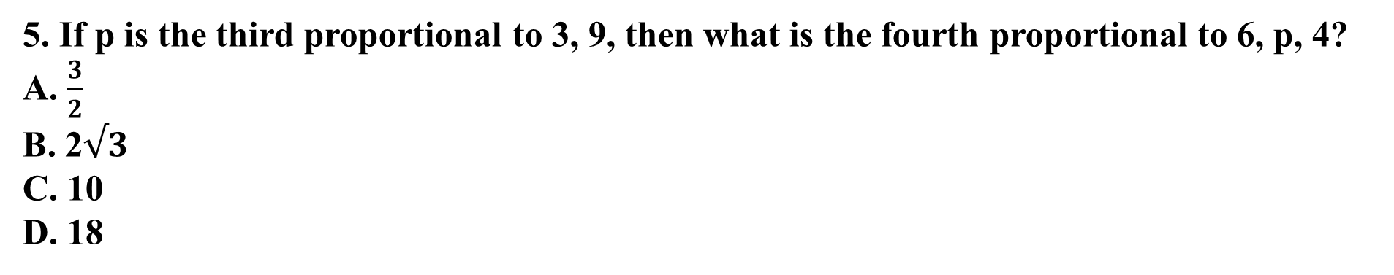
5. If p is the third proportional to 3, 9, then what is the fourth proportional to 6, p, 4?
A. $\frac{3}{2}$
B. 2$√3$
C. 10
D. 18
Department of Career Planning & Development (DCPD)
Notes:
Answer- D(Moderate)
Third proportional =$\frac{9X9}{3}$
Fourth proportional =$\frac{6}{27}$ = $\frac{4}{x}$
x = 18
14

Slide 15
6. The compounded ratio of (2 : 3), (6: 11) and (11 :2) is
1:2
2:1
11:24
36:121
Department of Career Planning & Development (DCPD)
Notes:
Answer- B (Easy)
Compounded Ratio :: When we compound two or more ratio's with each other through product or multiplication, the result is simply a compound ratio.
Thus, the product of two or more ratios; i.e, ab:cd is a ratio compounded of the simple ratios a:c and b:d.
Required compounded ratio = (2/3 x 6/11 x 11/2) = 2/1.
15

Slide 16
7. The sum of three numbers is 98. If the ratio of the first to second is 2 :3 and that of the second to the third is 5 : 8, then the second number is:
A. 20
B. 30
C. 48
D. 58
Department of Career Planning & Development (DCPD)
Notes:
Answe-B (Easy)
)Let the three parts be A, B, C. Then,
A : B = 2 : 3 and B : C = 5 : 8 =5 x3:8 x3= 3 :24555
A : B : C = 2 : 3 :24= 10 : 15 : 245
B =98 x15/49= 30
16

Slide 17
8.Two numbers are respectively 20% and 50% more than a third number. The ratio of the two numbers is:
A. 2 : 5
B. 3 : 5
C. 4 : 5
D. 6 : 7
Department of Career Planning & Development (DCPD)
Notes:
Answer-C (Easy)
Let the third number be x.
Then, first number = 120% of x =120x=6x100/5
Second number = 150% of x =150x=3x100/2
Ratio of first two numbers =6x :3x= 12x : 15x = 4 : 5
17

Slide 18
9.If 40% of a number is equal to two-third of another number, what is the ratio of first number to the second number?
A. 2 : 5
B. 3 : 7
C. 5 : 3
D. 7 : 3
Department of Career Planning & Development (DCPD)
Notes:
Answer- C (Easy)
Let 40% of A =⅔ of B
Then,40A=2B1003
2A=2B53
A=2x5=5B323
A : B = 5 : 3.
18

Slide 19
10. Rs. 2600 is divided into three parts A, B and C. How much A is more than C if their ratio is 1/2:1/3:1/4 ?
A) 600
B) 300
C) 150
D) 75
Department of Career Planning & Development (DCPD)
Notes:
Answer- A(Easy)
Explanation:
1/2:1/3:1/4 = 6:4:3
As the difference is 3
=> 3/13x2600 = 600
19

Slide 20
11. A sum of money is to be distributed among A, B, C, D in the proportion of 5 : 2 : 4 : 3. If C gets Rs. 1000 more than D, what is B's share?
A. Rs. 500
B. Rs. 1500
C. Rs. 2000
D. None of these
Department of Career Planning & Development (DCPD)
Notes:
Answer- B (Easy)
Let the shares of A, B, C and D be Rs. 5x, Rs. 2x, Rs. 4x and Rs. 3x respectively.
Then, 4x - 3x = 1000
x = 1000.
B's share = Rs. 2x = Rs. (2 x 1000) = Rs. 2000
20

Slide 21
12. A person divided Rs. 10800 among his three sons in the ratio 3 : 4 : 5. Second son kept Rs. 1000 for himself, gave Rs. 600 to his wife and divided the remaining money among his two daughters in the ratio 11 : 9. Then one of his daughters received.
(A) Rs. 1000
(B) Rs. 1050
(C) Rs. 1100
(D) Rs. 1150
Department of Career Planning & Development (DCPD)
Notes:
Ans: C (Expert)
Second son’s share = Rs. (10800×412) = Rs. 3600.
Money distributed between the two daughters
= Rs. [3600 – (1000 + 600)] = Rs. 2000.
First daughter’s share = Rs. (2000×11/20) = Rs. 1100.
Second daughter’s share = Rs. (2000×9/20) = Rs. 900.

Slide 22
13. The ratio of the number of boys and girls in a college is 7 : 8. If the percentage increase in the number of boys and girls be 20% and 10% respectively, what will be the new ratio?
A. 8 : 9
B.17 : 18
C. 21 : 22
D. Cannot be determined
Department of Career Planning & Development (DCPD)
Notes:
Answer-C (Easy)
Originally, let the number of boys and girls in the college be 7x and 8x respectively.
Their increased number is (120% of 7x) and (110% of 8x).
120x 7x /100 and 110x 8x/100
42x and 44x
The required ratio =42x:44x= 21 : 22
22

Slide 23
14. Seats for Mathematics, Physics and Biology in a school are in the ratio 5 : 7 : 8. There is a proposal to increase these seats by 40%, 50% and 75% respectively. What will be the ratio of increased seats?
A. 2 : 3 : 4
B. 6 : 7 : 8
C. 6 : 8 : 9
D. None of these
Department of Career Planning & Development (DCPD)
Notes:
Answer- A(Easy)
Originally, let the number of seats for Mathematics, Physics and Biology be 5x, 7x and 8x respectively.
Number of increased seats are (140% of 5x), (150% of 7x) and (175% of 8x).
7x,21x and 14x.2
The required ratio
14x : 21x : 28x
2 : 3 : 4.
23

Slide 24
15. Two number are in the ratio 3 : 5. If 9 is subtracted from each, the new numbers are in the ratio 12 : 23. The smaller number is:
A. 27
B. 33
C. 49
D. 55
Department of Career Planning & Development (DCPD)
Notes:
Answer- B (Easy)
Let the numbers be 3x and 5x.
Then,3x - 9=125x - 923
23(3x - 9) = 12(5x - 9)
9x = 99
x = 11.
The smaller number = (3 x 11) = 33.
24

Slide 25
16. Salaries of Ravi and Sumit are in the ratio 2 : 3. If the salary of each is increased by Rs. 4000, the new ratio becomes 40 : 57. What is Sumit's salary after increment?
A. Rs. 17,000
B. Rs. 20,000
C. Rs. 25,500
D. Rs. 38,000
Department of Career Planning & Development (DCPD)
Notes:
Answer(D) (Moderate)
Let the original salaries of Ravi and Sumit be Rs. 2x and Rs. 3x respectively.
Then,2x + 4000=3x + 4000
57(2x + 4000) = 40(3x + 4000)
6x = 68,000
3x = 34,000
Sumit's present salary = (3x + 4000) = Rs.(34000 + 4000) = Rs. 38,000.
25

Slide 26
17. In a bag, there are coins of 25 p, 10 p and 5 p in the ratio of 1 : 2 : 3. If there is Rs. 30 in all, how many 5 p coins are there?
A. 50
B. 100
C. 150
D. 200
Department of Career Planning & Development (DCPD)
Notes:
Answer- C (Moderate)
Let the number of 25 p, 10 p and 5 p coins be x, 2x, 3x respectively.
Then, sum of their values = Rs.0.25x+0.10 x 2x+0.5 x 3x= Rs.0.60x
0.60x= 30 x =50
Hence, the number of 5 p coins = (3 x 50) = 150.
26

Slide 27
18. A box contains 280 coins of one-rupee, 50-paise and 25-paise. The values of each kind of the coins are in the ratio of 8:4:3. Then the number of 50-paise coins is.
A. 50
B. 80
C. 120
D. 200
Department of Career Planning & Development (DCPD)
Notes:
Answer- B (Moderate)
Rs 1 50p 25p
Value 8 4 3
No. of coins 8 8 12
Total no of coins=28
28 coins =280
1 coins = 10
No. of 50 paise coins = 8×10 =80 Ans.
27

Slide 28
19. A and B are two alloys of gold and copper prepared by mixing metals in the ratio 7 : 2 and 7 : 11 respectively. If equal quantities of the alloys are melted to form a third alloy C, then the ratio of gold and copper in alloy C will be
(A) 5 : 7
(B) 5 : 9
(C) 7 : 3
(D) 7 : 5
Department of Career Planning & Development (DCPD)
Notes:
Ans: D (Moderate)
Gold in C = (79+718) units = 76 units.
Copper in C = (29+1118) units = 56 units.
∴ Gold : Copper = 76:56 = 7 : 5.

Slide 29
20. In an alloy, the ratio of copper and zinc is 5 : 2. If 1.250 kg of zinc is mixed in 17 kg 500 g of alloy, then the ratio of copper and zinc in the alloy will be
(A) 1 : 2
(B) 2 : 1
(C) 2 : 3
(D) 3 : 2
Department of Career Planning & Development (DCPD)
Notes:
Ans: B(Moderate)
Quantity of copper in 17.5 kg of alloy = (17.5×5/7) kg = 12. 5 kg.
Quantity of zinc in 17.5 kg of alloy = (17.5×2/7) kg = 5 kg.
∴ Required ratio = 12.5 : (5 + 1.25) = 12.5 : 6.25 = 2 : 1.

Slide 30
22. Paint needs to be thinned to a ratio of 2 parts paint to 1.5 parts water. The painter has by mistake added water so that he has 6 litres of paint which is half water and half paint. What must he add to make the proportions of the mixture correct?
A) 1 litre paint
B) 1 litre water
C) ½ litre water and one litre paint
D) ½ litre paint and one litre water
Department of Career Planning & Development (DCPD)
Notes:
Answer: A) 1 litre paint (Moderate)
Explanation:
At the moment the paint is 3 liters of paint and 3 liters of water. We need to add to this to make the new ratio 2 liters paint to 1.5 liters water. As this is equivalent to 4 : 3 we can see that we have the right amount of water, and just need 1 liter of paint to make it correct.
30

Slide 31
23. There are two containers, the first one contains 1 litre pure water and the second one contains 1 litre pure milk. Now 5 cups of water from the first container is taken out is mixed well in the second container. Then, 5 cups of this mixture is taken out and is mixed in the first container. Let A denote the proportion of milk in the first container and B denote the proportion of water in the second container then:
A) A
B) A=B
C) A>B
D) can't be determined
Department of Career Planning & Development (DCPD)
Notes:
Answer: B) A=B (Expert)
Explanation:
Here the ratio of mixtures( i.e milk , water) doesnot matter. But the important point is that whether the total amount ( either pure or mixture ) being transferred is equal or not.Since the total amount ( i.e 5 cups) being transferred from each one to another , hence A =B.
31

Slide 32
24. In two types of powdered detergent the ratio of soda and soap dust is 2 : 19 and 1 : 11 respectively, if 7 kg of the first type is mixed with 4 kg of the second type, find the ratio of soda to soap dust in the new detergent mixture.
(A) 1 : 9
(B) 1 : 10
(C) 9 : 1
(D) 20 : 1
Department of Career Planning & Development (DCPD)
Notes:
Ans: B(Expert)
Quantity of soda in the mixture
= (7×221+4×112) kg = (23+13)kg = 1 kg.
Quantity of soap dust in the mixture
= [(7 + 4) - 1] kg = 10 kg.
∴ Required ratio = 1 : 10.

Slide 33
25. One year ago the ratio between Maneela’s and Shanthi’s salary was 3 : 4. The ratios of their individual salaries between last year’s and this year’s salaries are 4 : 5 and 2 : 3 respectively. At present the total of their salary is Rs. 4160. The salary of Maneela, now is?
Rs. 1600
Rs. 1700
Rs. 1800
Rs. 1900
Department of Career Planning & Development (DCPD)
Notes:
Answer: A) Rs. 1600 (Moderate)
Explanation:
Let the salaries of Maneela and Shanthi one year before be M1, S1 & now be M2, S2 respectively.
Then, from the given data,
M1/S1 = 3/4 .....(1)
M1/M2 = 4/5 .....(2)
S1/S2 = 2/3 .....(3)
and M2 + S2 = 4160 .....(4)
Solving all these eqtns, we get M2 = Rs. 1600.
33

Slide 34

26. Three cats are roaming in a zoo in such a way that when cat A takes 5 steps, B takes 6 steps and C takes 7 steps. But the 6 steps of A are equal to the 7 steps of B and 8 steps of C. what is the ratio of their speeds?
A) 140:144:147
B) 40:44:47
C) 15:21:28
D) 252:245:240
Department of Career Planning & Development (DCPD)
Notes:
Answer: A) 140:144:147(Moderate)
Explanation:
Frequency of step of A:B:C = 5 : 6 : 7
But in terms of size of step, 6A = 7B = 8C
Therefore, Ratio of speeds of A, B and C = 5/6 : 6/7 : 7/8 = 140 : 144 : 147
34

Slide 35
27. Rice worth Rs. 126 per kg and Rs. 135 per kg are mixed with a third variety in the ratio 1 : 1 : 2. If the mixture is worth Rs. 153 per kg, then the price of third variety of rice per kg?
A) Rs. 571.25
B) Rs. 175.5
C) Rs. 751.75
D) Rs. 850
Department of Career Planning & Development (DCPD)
Notes:
Answer: B) Rs. 175.5 (Moderate)
Explanation:
Let the price of required variety = Rs. P/kg
Then, respective amounts were m kg, m kg and 2m kg
= 126m + 135m + 2pm = 153 x 4m
=> 2p = 351
p = 175.5 / kg
35

Slide 36
28. 80 litres of diesel is required to travel 800 km using a 800 cc engine. If the volume of diesel required to cover a distance varies directly as the capacity of the engine, then how many litres of diesel is required to travel 1000 kms using 1200 cc engine ?
A) 120 lit
B) 140 lit
C) 110 lit
D) 150 lit
Department of Career Planning & Development (DCPD)
Notes:
Answer: D) 150 lit (Expert)
Explanation:
To cover a distance of 800 kms using a 800 cc engine, the amount of diesel required = 80 litres.
=> the amount of diesel required to cover a distance of 1000 kms = 1000 x 80/800 = 100 litres
However, the vehicle uses a 1200 cc engine and it is given that the amount of diesel required varies directly as the engine capacity.
i.e., for instance, if the capacity of engine doubles, the diesel requirement will double too.
Therefore, with a 1200 cc engine, quantity of diesel required = 1200/800 x 100 = 150 litres.
36

Slide 37
29. In a fort, there are 1200 soldiers. If each soldier consumes 3 kg per day, the provisions available in the fort will last for 30 days. If some more soldiers join, the provisions available will last for 25 days given each soldier consumes 2.5 kg per day. Find the number of soldiers joining the fort in that case ?
A) 693
B) 741
C) 528
D) 654
Department of Career Planning & Development (DCPD)
Notes:
Answer: C) 528 (Expert)
Explanation:
Assume x soldiers join the fort. 1200 soldiers have provision for 1200 (days for which provisions last them)(rate of consumption of each soldier)
= (1200)(30)(3) kg.
Also provisions available for (1200 + x) soldiers is (1200 + x)(25)(2.5) k
As the same provisions are available
=> (1200)(30)(3) = (1200 + x)(25)(2.5)
x = ([(1200)(30)(3)] / (25)(2.5)) - 1200 => x = 528.
37

Slide 38
30. Maneela, Raghu and Aravind have some jems with each of them. Five times the number of jems with Raghu equals seven times the number of jems with Maneela while five times the number of jems with Maneela equals seven times the number of jems with Aravind. What is the minimum number of jems that can be there with all three of them put together ?
A) 108
B) 107
C) 109
D) 110
Department of Career Planning & Development (DCPD)
Notes:
Answer: C) 109 (Moderate)
Explanation:
From given data,
R : M = 5 : 7
M : A = 5 : 7
R : M : A = 25 : 35 : 49
25 + 35 + 49 = 109
38

Slide 39
31. There is certain numbers of toys in the box. They are divided into such a way that the person who gets 1/4 of the whole gets thrice of what the others get on an average. Find the number of people amongst whom the toys are distributed?
A) 8
B) 10
C) 12
D) 9
Department of Career Planning & Development (DCPD)
Notes:
Answer: B) 10(Moderate)
Explanation:
If the person who gets 1/4 of the whole gets thrice of what the others get on an average, each one will get =1/3×1/4=112 of the whole.
Therefore, if there are k persons other than the person who gets one-fourth, then 1/4 + k/12 = 1
⇒ k=9
Hence, total number of people = 10.
39

Slide 40
32. In Maa Yatri Temple every devotee offers fruits to the orphans. Thus every orphan receives bananas, oranges and grapes in the ratio of 3:2:7 in terms of dozens. But the weight of a grape is 24 gm and weight of a banana and an orange are in the ratio of 4:5, while the weight of an orange is 150gm. Find the ratio of all the three fruits in terms of weight, that an orphan gets
A) 90:75:42
B) 180:150:82
C) 75:42:90
D) None of these
Department of Career Planning & Development (DCPD)
Notes:
Answer: D) None of these (Expert)
Explanation:
Ratio of fruits (by dozen) = 3:2:7
Ratio of fruits (by weight) = 120 :150: 24
Therefore, Ratio of fruits (combined) by weight = 3 x 120 : 2 x 150 : 7 x 24 = 30 : 25 : 14
40

Slide 41
33. The respective ratio of the salary of Nita and Sita is 3 : 4. What is the ratio of their saving?
Statement I: Sita saves 25% of her salary.
Statement II: The saving of Sita is Rs. 4500.
Statement III: The respective ratio of the expenditures of Nita & Sita is 4 : 5.
Either statement III alone or statements I and II together are sufficient.
Only statement III is sufficient.
Only statement I and III is sufficient.
Only statement I, II, and III are sufficient.
None of these
Notes:
Correct Option:- C

Slide 42
34. Two vessels contain milk and water in the ratio 4:3 and 5:2, respectively. How many liters of the mixture from the first vessel must be added to the second vessel to get a new mixture containing milk and water in the ratio 3:1?
Statements:
The quantity of the mixture in the first vessel is 28 liters.
The quantity of the mixture in the second vessel is 14 liters.
A) Statement 1 alone is sufficient, but statement 2 alone is not sufficient.
B) Statement 2 alone is sufficient, but statement 1 alone is not sufficient.
C) Both statements together are sufficient, but neither statement alone is sufficient.
D) Each statement alone is sufficient.
E) Statements 1 and 2 together are not sufficient.
Notes:
Correct option:- C
Neither Statement 1 nor Statement 2 alone provides enough information about the total quantities and the required addition to achieve the final ratio. However, when combined, we can calculate the final mixture.
Correct Answer: C) Both statements together are sufficient, but neither statement alone is sufficient.

Slide 43
35. The incomes of A, B, and C are in the ratio 2:3:5. What is B’s income?
Statements:
The difference between A’s and C’s income is $4000.
The sum of B’s and C’s income is $8000.
A) Statement 1 alone is sufficient, but statement 2 alone is not sufficient.
B) Statement 2 alone is sufficient, but statement 1 alone is not sufficient.
C) Both statements together are sufficient, but neither statement alone is sufficient.
D) Each statement alone is sufficient.
E) Statements 1 and 2 together are not sufficient.
Notes:
Correct option :- D

Slide 44
36. In a company, the ratio of the number of male employees to the number of female employees is 7:5. How many male employees are there in the company?
Statements:
There are 180 more male employees than female employees.
The total number of employees in the company is 720.
A) Statement 1 alone is sufficient, but statement 2 alone is not sufficient.
B) Statement 2 alone is sufficient, but statement 1 alone is not sufficient.
C) Both statements together are sufficient, but neither statement alone is sufficient.
D) Each statement alone is sufficient.
E) Statements 1 and 2 together are not sufficient.
Notes:
Correct Answer: A
Statement 1 alone is sufficient, but statement 2 alone is not sufficient.

Slide 45
Passage based question
The number of students in two classes A and B is equal. Each girl in class A has thrice the number of girls as classmates as she has boys as class mates, while each girl in class B has thrice the number of boys as classmates as she has girls as class mates. Each boy of class A has five times the number of girls as classmates as he has boys as class mates.
1. What is the ratio of the total number of boys and girls in class A?
A. 4 B. 6 C. 3 D. None
Notes:
Step 1: Define Variables
Let G_{A} and B_{A} represent the number of girls and boys in class A, respectively.
Let G_{B} and B_{B} represent the number of girls and boys in class B, respectively.
Step 2: Equations for Class A
G_{A} - 1 = 3B_{A}
G_{A} = 5(B_{A} - 1)
Step 3: Solve for Class A
Substitute G_{A} = 3B_{A} + 1 into G_{A} = 5(B_{A} - 1):
3B_{A} + 1 = 5(B_{A} - 1)
3B_{A} + 1 = 5B_{A} - 5
2B_{A} = 6
B_{A} = 3
G_{A} = 3(3) + 1 = 10
Step 4: Equations for Class B
B_{B} = 3(G_{B} - 1)
G_{A} + B_{A} = G_{B} + B_{B} => 13 = G_{B} + B_{B}
Step 5: Solve for Class B
Substitute B_{B} = 3(G_{B} - 1) into 13 = G_{B} + B_{B}:
13 = G_{B} + 3(G_{B} - 1)
13 = 4G_{B} - 3
4G_{B} = 16
G_{B} = 4
B_{B} = 3(4 - 1) = 9
Step 6: Calculate Ratio
Total boys = B_{A} + B_{B} = 3 + 9 = 12
Total girls = G_{A} + G_{B} = 10 + 4 = 14

Slide 46
Passage based question
The number of students in two classes A and B is equal. Each girl in class A has thrice the number of girls as classmates as she has boys as class mates, while each girl in class B has thrice the number of boys as classmates as she has girls as class mates. Each boy of class A has five times the number of girls as classmates as he has boys as class mates.
2. What is the total number of boys and girls in class A?
A. 14 B. 16 C. 12 D. None
Notes:
Step 1: Define Variables
Let G_{A} and B_{A} represent the number of girls and boys in class A, respectively.
Let G_{B} and B_{B} represent the number of girls and boys in class B, respectively.
Step 2: Equations for Class A
G_{A} - 1 = 3B_{A}
G_{A} = 5(B_{A} - 1)
Step 3: Solve for Class A
Substitute G_{A} = 3B_{A} + 1 into G_{A} = 5(B_{A} - 1):
3B_{A} + 1 = 5(B_{A} - 1)
3B_{A} + 1 = 5B_{A} - 5
2B_{A} = 6
B_{A} = 3
G_{A} = 3(3) + 1 = 10
Step 4: Equations for Class B
B_{B} = 3(G_{B} - 1)
G_{A} + B_{A} = G_{B} + B_{B} => 13 = G_{B} + B_{B}
Step 5: Solve for Class B
Substitute B_{B} = 3(G_{B} - 1) into 13 = G_{B} + B_{B}:
13 = G_{B} + 3(G_{B} - 1)
13 = 4G_{B} - 3
4G_{B} = 16
G_{B} = 4
B_{B} = 3(4 - 1) = 9
Step 6: Calculate Ratio
Total boys = B_{A} + B_{B} = 3 + 9 = 12
Total girls = G_{A} + G_{B} = 10 + 4 = 14

Slide 47
Passage based question
The number of students in two classes A and B is equal. Each girl in class A has thrice the number of girls as classmates as she has boys as class mates, while each girl in class B has thrice the number of boys as classmates as she has girls as class mates. Each boy of class A has five times the number of girls as classmates as he has boys as class mates.
3. What is the ratio of the total number of boys and girls in the two classes?
A. 6:7 B.7:6 C.1:2 D.3:2
Notes:
Step 1: Define Variables
Let G_{A} and B_{A} represent the number of girls and boys in class A, respectively.
Let G_{B} and B_{B} represent the number of girls and boys in class B, respectively.
Step 2: Equations for Class A
G_{A} - 1 = 3B_{A}
G_{A} = 5(B_{A} - 1)
Step 3: Solve for Class A
Substitute G_{A} = 3B_{A} + 1 into G_{A} = 5(B_{A} - 1):
3B_{A} + 1 = 5(B_{A} - 1)
3B_{A} + 1 = 5B_{A} - 5
2B_{A} = 6
B_{A} = 3
G_{A} = 3(3) + 1 = 10
Step 4: Equations for Class B
B_{B} = 3(G_{B} - 1)
G_{A} + B_{A} = G_{B} + B_{B} => 13 = G_{B} + B_{B}
Step 5: Solve for Class B
Substitute B_{B} = 3(G_{B} - 1) into 13 = G_{B} + B_{B}:
13 = G_{B} + 3(G_{B} - 1)
13 = 4G_{B} - 3
4G_{B} = 16
G_{B} = 4
B_{B} = 3(4 - 1) = 9
Step 6: Calculate Ratio
Total boys = B_{A} + B_{B} = 3 + 9 = 12
Total girls = G_{A} + G_{B} = 10 + 4 = 14
Ratio of boys to girls = 12/14 = 6/7
Final Answer
6/7

Slide 48


